Slide 1
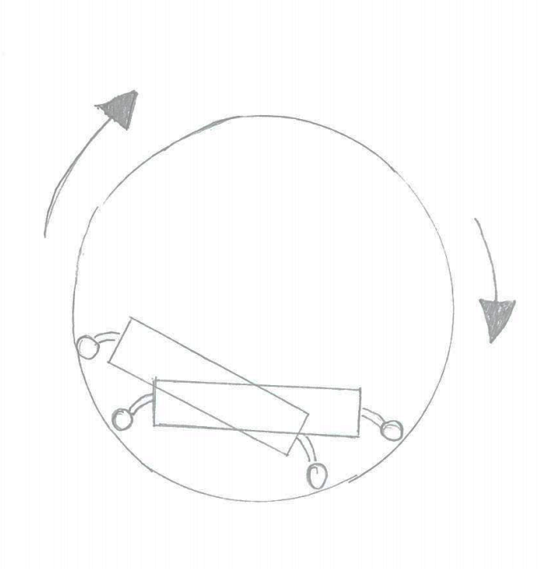
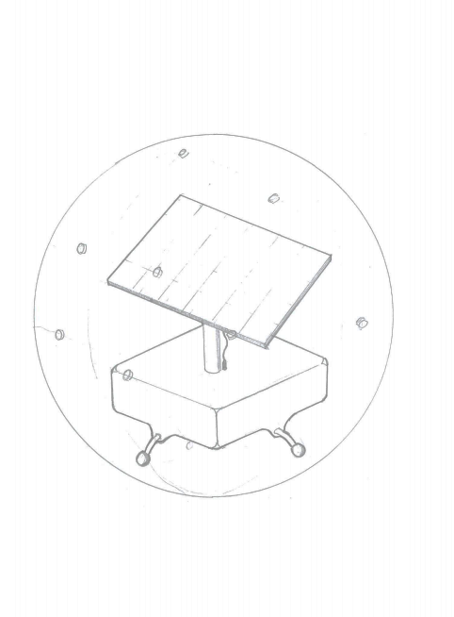
Transparent, 2 part perforated hemispheres
Solar Panel
Electronics enclosure
Universal transfer bearings

Slide 2
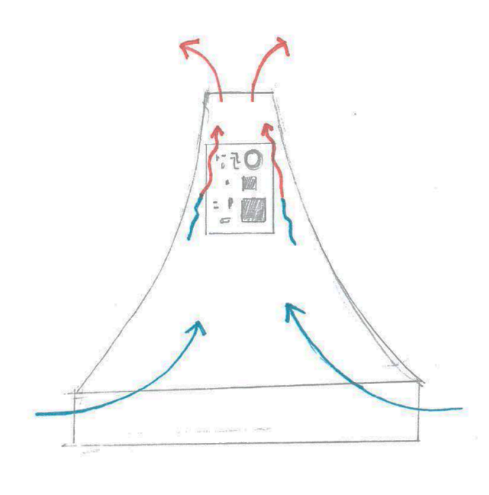
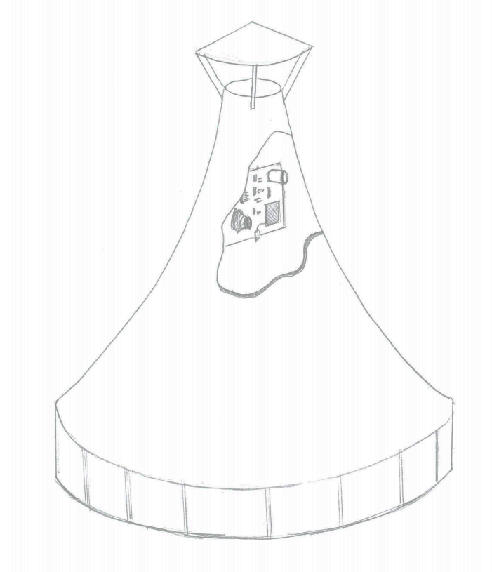
Rain cover, elevated to allow air flow
Electronics and sensors mounted vertically inside chimney
Open segments to allow air intake

Slide 3
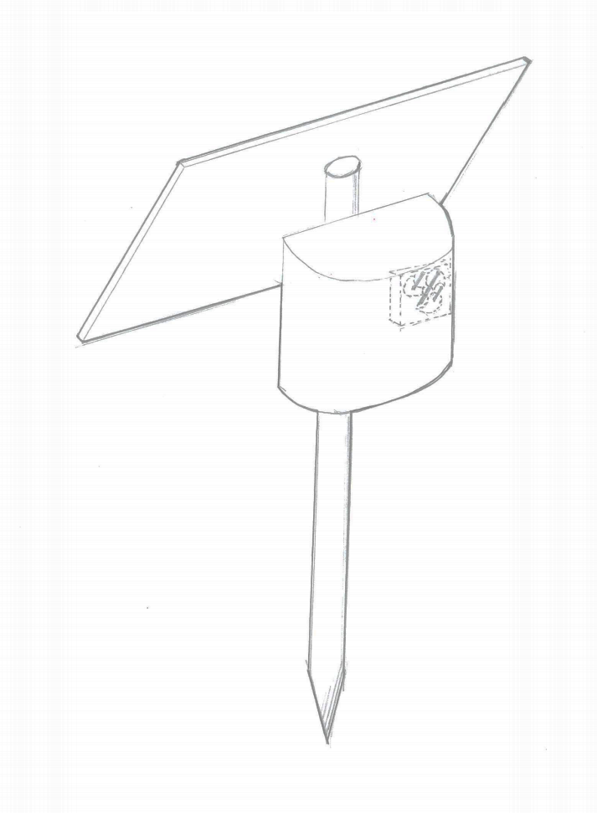
Solar Panel
Slits for allowing air flow
Electric fan
Electronics Enclosure
Universal transfer bearings

Slide 4
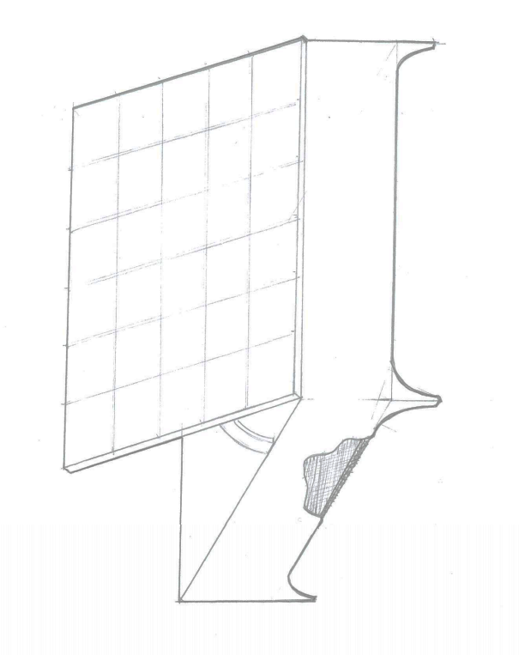
Solar Panel
Electronics and sensors mounted vertically inside chimney
Underside of sensor air permeable mesh

